Slide 1

Project- Part A: Airbnb Price Prediction and Insights
MACHINE LEARNING
Submitted by: Satish Kumar

Slide 2
Project Overview
Airbnb a platform to helps property owners rent out spaces to travelers.
Aim: to build a machine learning model to predict the price of Airbnb listings
Based on various features such as:
-property type,
-room type,
-location,
-amenities,
Goal: Predict listing prices using property, room type, location, etc.

Slide 3
Problem Statement
Objective: to develop a regression model that predicts the price of an Airbnb listing.
Build a regression model to predict Airbnb listing prices accurately.
Provide Recommendations with insights to set optimal prices and improve satisfaction.

Slide 4

1. Data Collection Dataset Information: CSV File Load the dataset and IMPORT Python Libraries
Dataset: Airbnb data csv
Includes:
Room Type
Property Type
Amenities
Reviews
Location Info

Slide 5
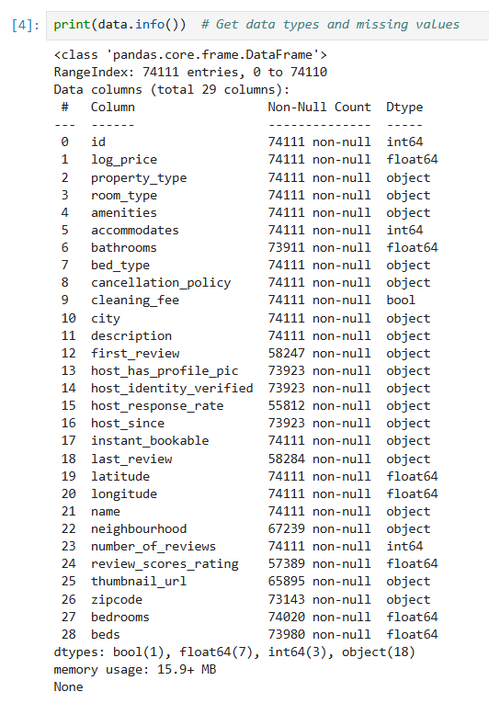
2. Data Cleaning
Finding Missing values
Null values

Slide 6
3. Data Exploratory and Analysis
Distribution of Log Price: shows Smooth Distribution
Distribution of Room Types: Majority listings are Entire Home/Apartment
Numeric features: like Average Log Prices, Mostly are Entire Home/Apt
Correlated: More Bathrooms with Higher Prices
Reviews: Mid Ranges Price-Higher no. of Reviews while Luxury fewer.
Geographic: cluster shows near major cities with distinct Room Types

Slide 7
4. Data Preprocessing Boxplot Outlier Analysis
Outliers
Handling missing values for numeric and non-numeric columns
Handling Outliers: Accommodation, Rooms, Reviews, Ratings,
Listing the prices
Outliers exit for luxury accommodations with fewer guest capacities,
Co-relates: Higher guest capacity with Higher Prices.

Slide 8
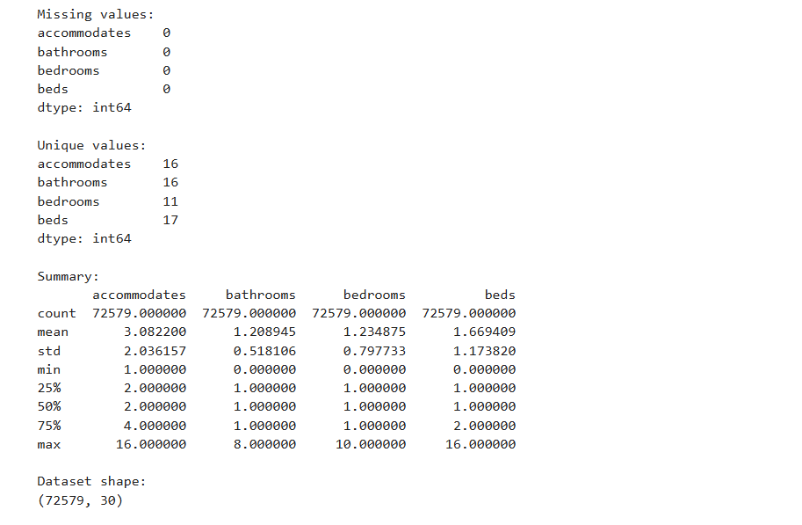
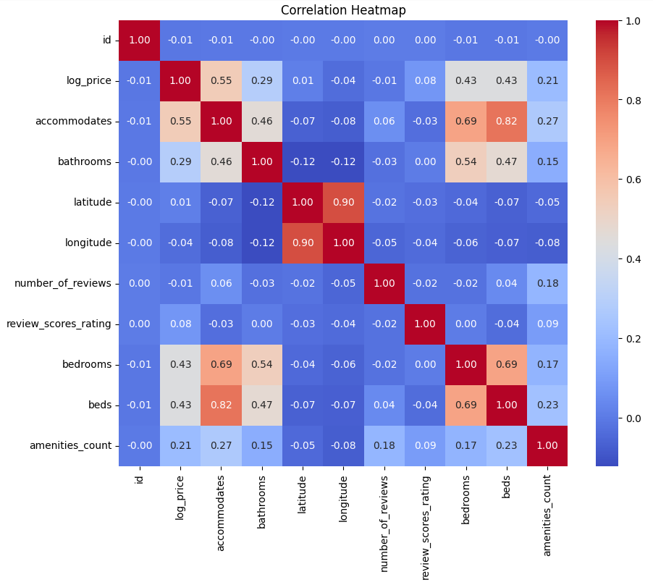
5. Feature Engineering Amenities Column
Summary of the Column Correlation Heatmap

Slide 9
6. Data Modeling
Select and Define the Features and Target
Split data into training and testing sets
1. Data exploration & preprocessing: Feature Engineering
2. Linear Regression model, Random Forest,
3. Gradient Boosted Decision Tree (GBDT): Extreme Gradient Boosting
(XG Boost)

Slide 10
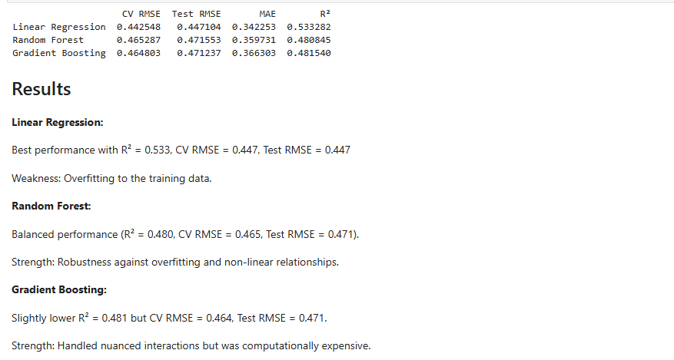
7. Data Evaluation: Cross Validation Results: Linear Regression provided the best R², but ensemble methods like Random Forest showed better overall robustness.

Slide 11
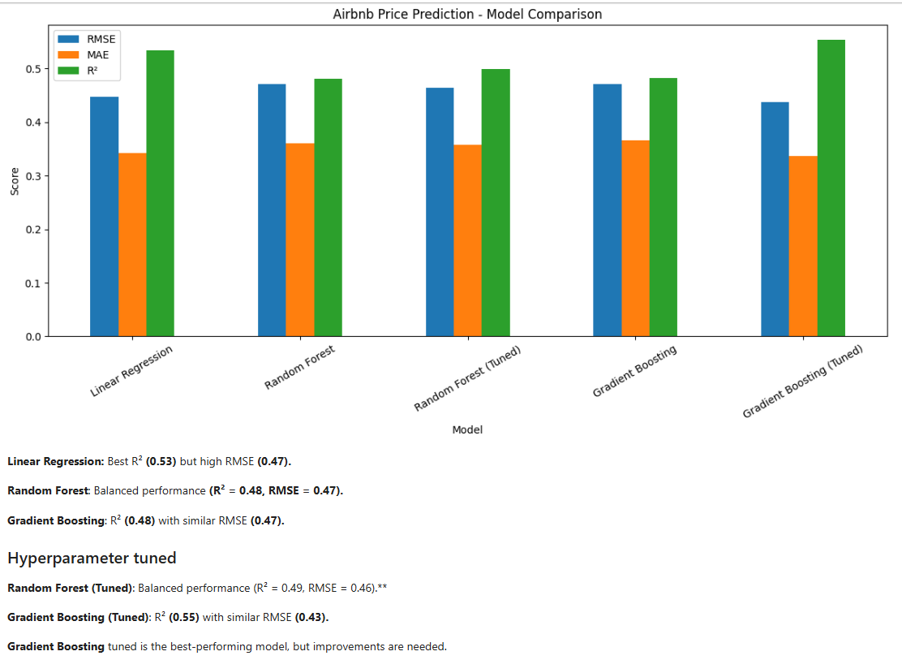
8. Model Selection and Comparison
Hyperparameter Tuning: Best Model methods to deliver strong predictions.

Slide 12
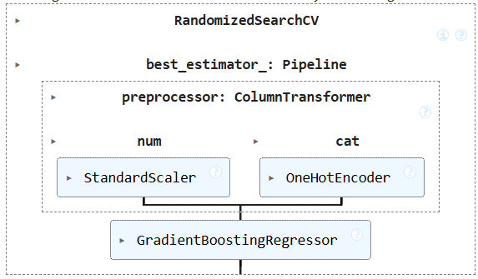
9. Final Model Selection & Evaluation
Gradient Boosting Model

Slide 13
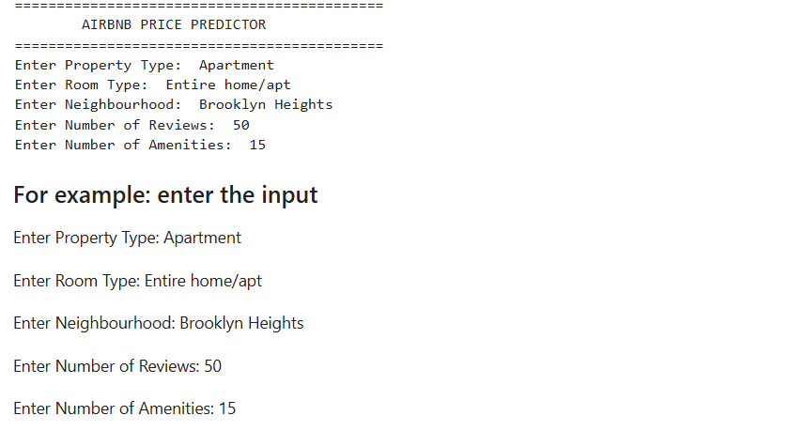
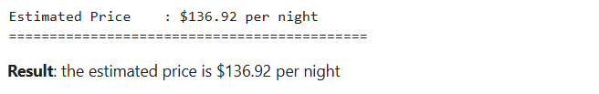
10. Prediction: Enter User Input
Gradient Boosting Model

Slide 14
Key Insights:
Room Type and Prototype are important factors affecting Airbnb prices.
Neighborhood/location plays a significant role in determining listing prices.
Number of reviews provides useful information about listing activity, but more reviews do not necessarily mean higher prices.
Gradient Boosting performed best after hyperparameter tuning.
Final model performance: R²: 0.5533 RMSE: 0.4374 MAE: 0.3359
The model can predict prices for new Airbnb listings, such as the demonstrated $136.92/night prediction.

Slide 15
Recommendations
Hosts should compare their price with similar properties in the same neighborhood.
Providing and highlighting useful amenities can support competitive pricing.
Use the model as a pricing benchmark, not as an exact guaranteed price.
Add more features such as accommodates, bedrooms, bathrooms, beds, review rating, and location coordinates to improve prediction accuracy.
Improve amenities count by identifying specific amenities such as Wi-Fi, parking, pool, kitchen, and air conditioning.
Analyze premium/luxury listings separately, because the model may underpredict some high-priced properties.

Slide 16
Conclusion
This project developed an Interactive Prototype with analytical pipeline in Airbnb price prediction system using
data preprocessing, exploratory data analysis, feature engineering, model comparison, and hyperparameter tuning.
The final tuned Gradient Boosting model achieved an R² of 0.5533, RMSE of 0.4374**, and MAE of 0.3359 on the test dataset. The model can estimate prices for new Airbnb listings, such as the demonstrated $136.92 per-night estimate.

Slide 17
Thank You

